Slide 1
THE PERSUASIVE ESSAY
Introduction to the “Robotman” Structure

Slide 2
WHAT IS A PERSUASIVE ESSAY?
An essay that states your position (stance) on a particular issue and supports your opinion with logical reasons and evidence.

Slide 3
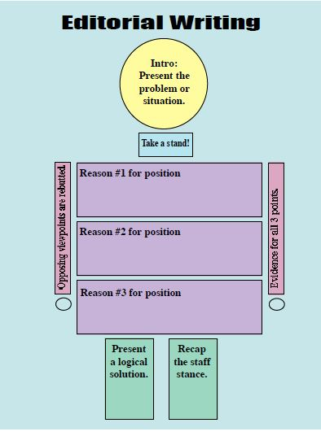
PERSUASIVE WRITING USING THE ROBOT MAN STRUCTURE
By Jeanne Acton, UIL and ILPC Journalism Director

Slide 4
SAMPLE EDITORIAL THAT USES THE ROBOT MAN STRUCTURE
The “head” of the essay
For example: Almost every day on the morning announcements, Ms. Smith reminds the students to clean up after themselves during the lunch. However, not all students are helping keep the school clean and safe.
(Hint: Sometimes the best way to do this is just to put the “think about” part of the prompt in your own words.)
Intr
o:
Pr
esent
both sides
of the
pr
oblem or
situation.
By Jeanne Acton, UIL and ILPC Journalism Director

Slide 5
THE “NECK” OF YOUR PERSUASIVE ESSAY
For example:
Students need to take pride in their school and treat it with respect because trash in the hallways is unfair to the custodians, it can cause a safety hazard, and a messy school reflects badly on its students and faculty.
What is your opinion?

Slide 6
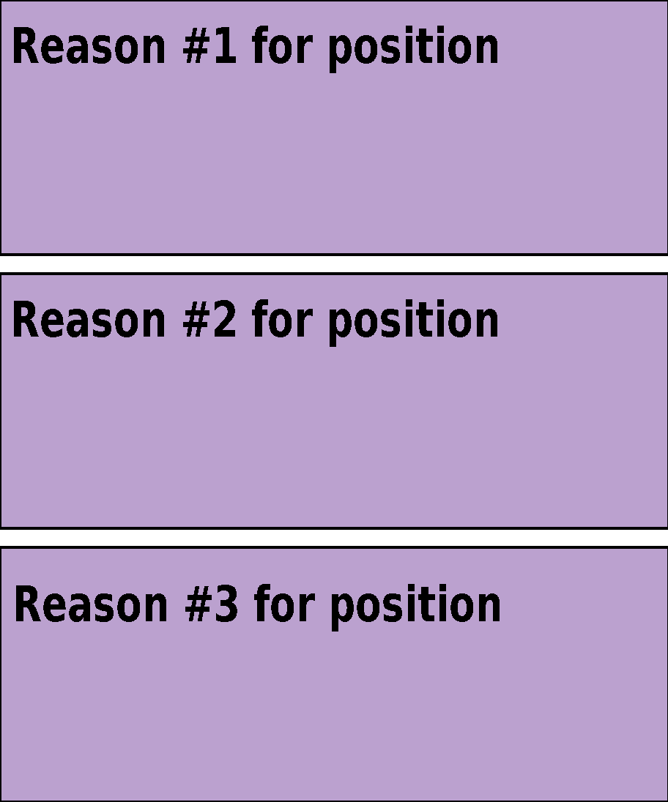
THE BODY OF YOUR EDITORIAL
Give three reasons why you are taking your stand. (On STAAR, you would choose your best two.)
First of all, the custodians clean all day long and are some of the hardest working people in the school.
2. Also, as Ms. Smith has stated many times, trash on the ground is a safety hazard.
3. Finally, a school that
is not clean reflects badly on its students and faculty.

Slide 7
THE ARMS OF THE EDITORIAL (PART OF YOUR BODY PARAGRAPHS)
Support your arguments with evidence and examples.
Also, as our principal has stated many times, trash on the ground is a safety hazard. Many students and teachers have complained about slipping on ketchup packets, tator tots, and other foods smeared on the ground. In fact, in Chicago, two separate women have filed lawsuits against Kroger Grocery Stores for injuries they received from slipping on grapes. Faculty members or students could easily slip and fall at our school, which could result in costly lawsuits.

Slide 8
THE OTHER ARM OF THE EDITORIAL (OR A LEG, DEPENDING ON HOW YOU DO IT)
Opposing viewpoints are rebutted. You shut down the opposition.
Some people think that it’s the custodians’ job to pick up trash. However, a custodian’s job involves much more than cleaning. They have to maintain the building. If they are swamped with having to clean up students’ trash, they can’t do other things like change light bulbs in classrooms, move furniture, paint, and ensure conditions are safe for students and teachers alike.

Slide 9
THE LEG OF THE EDITORIAL
Students need to take a more active role in helping to maintain the school’s appearance. Students should encourage one another to be both responsible and respectful by cleaning up after themselves.

